Slide 1
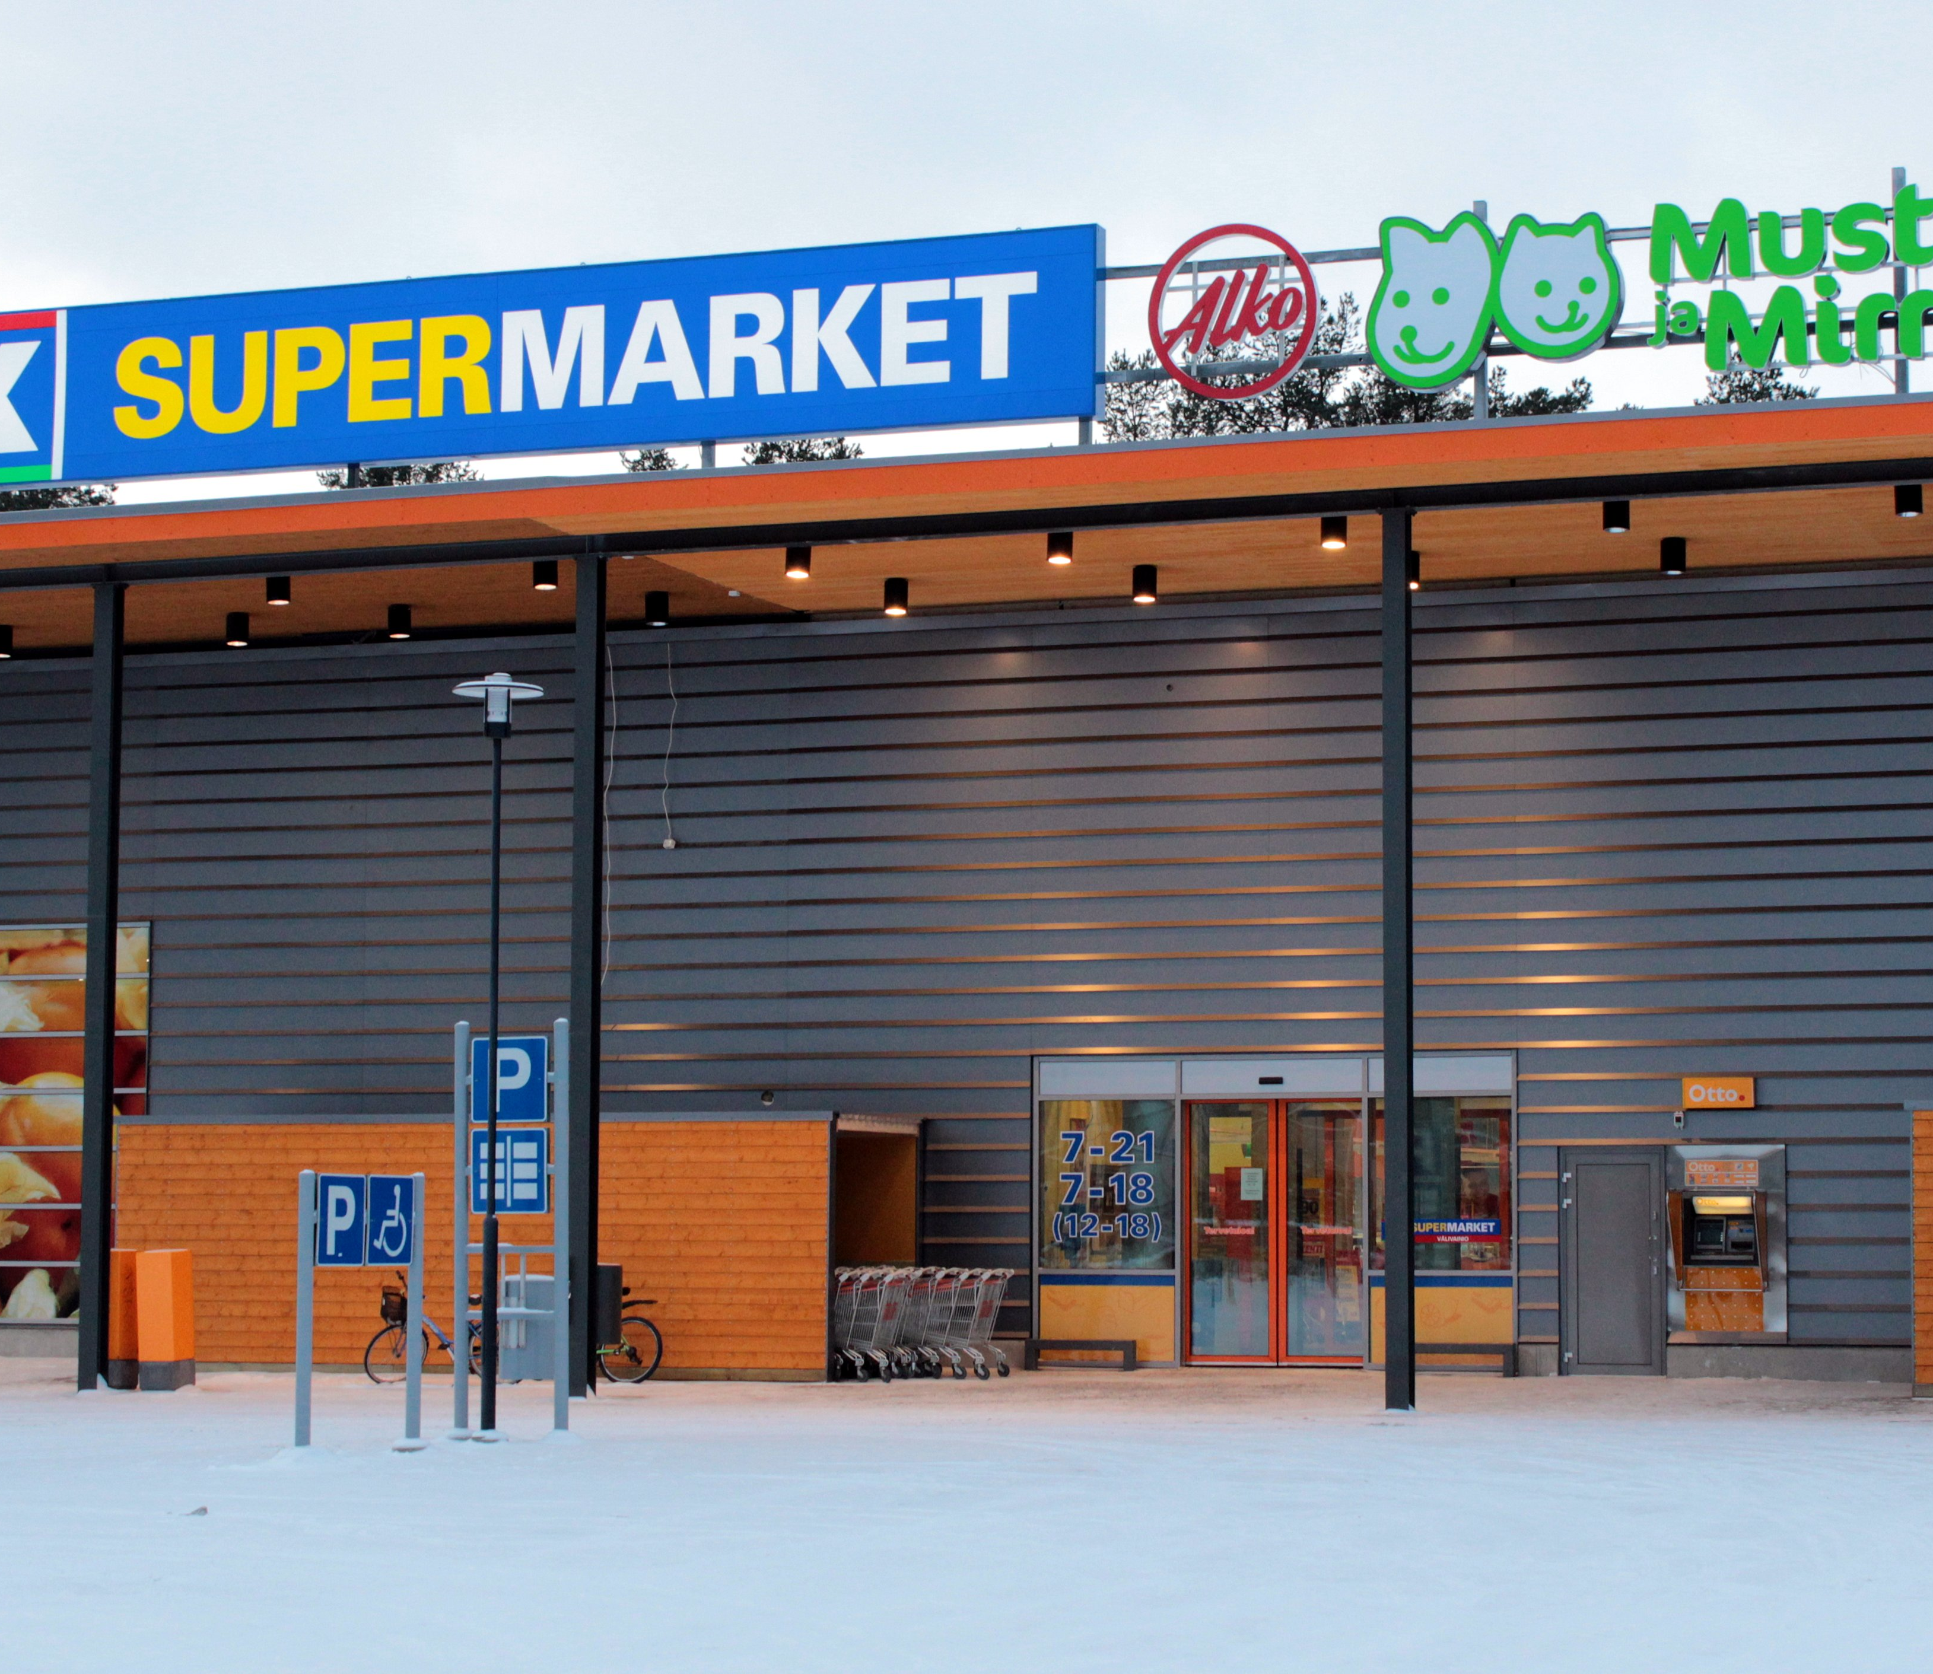
PREMIER SUPERMARKET SALES DATA ANALYSIS REPORT
By Adejobi Anuoluwapo
This Photo by Unknown Author is licensed under CC BY-SA

Slide 2

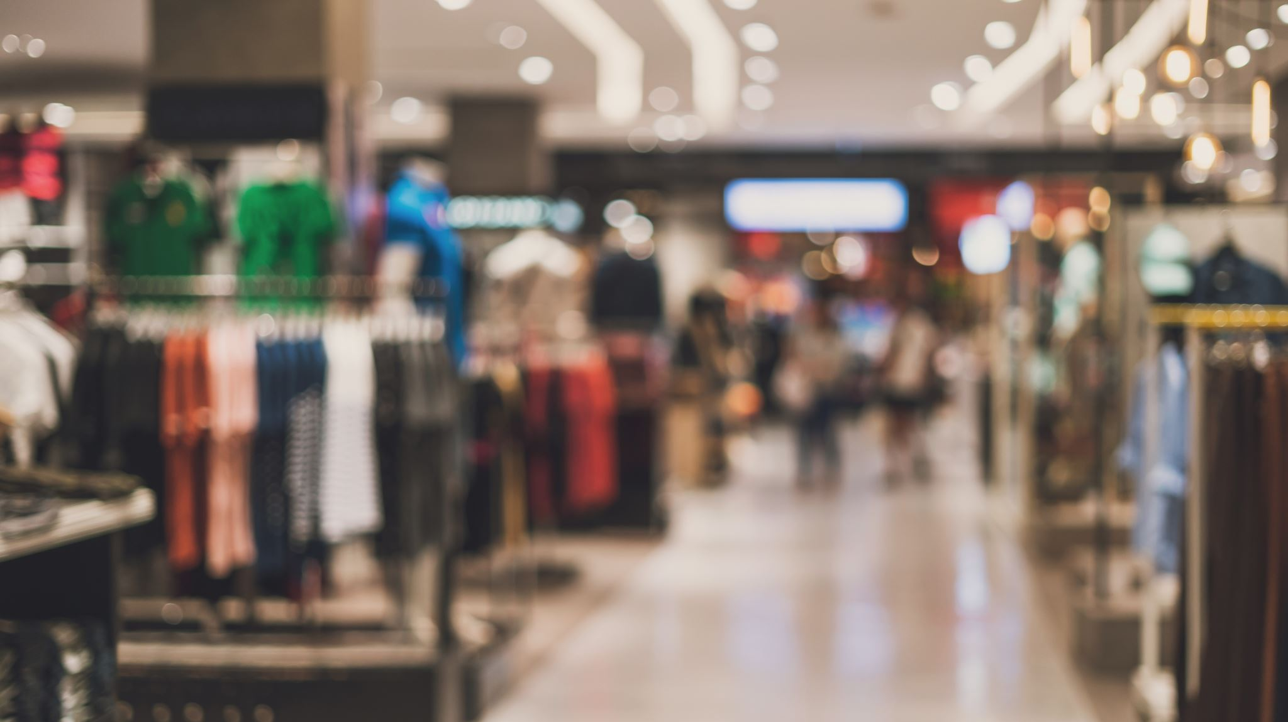
INTODUCTION
Premier supermarket is a mid-sized grocery store chain with three branches A, B, and C in the city of Myanmar, namely: Yangon, Naypyitaw, and Mandalay.
Total transactions of 1000 were made from 1st of January to 31st of March 2019.
There are 6 product lines in the supermarket, namely: Electronics accessories, fashion accessories, health and beauty, food and beverages, home and lifestyle, sports and travel.
Customer types are members and non-members.
Three mode of payments are used which are: Credit card, cash, and e-wallet

Slide 3
PROBLEM STATEMENT
The Supermarket, a mid-sized grocery store chain, has been struggling with declining profits over the past three months. Despite a consistent customer base and stable sales volume, the supermarket is not achieving the expected profit margins. This issue is critical as it threatens the sustainability and growth potential of the business.

Slide 4
OBJECTIVE
To identify and implement strategic changes that will increase the profitability of the Supermarket within the next 12 months.

Slide 5
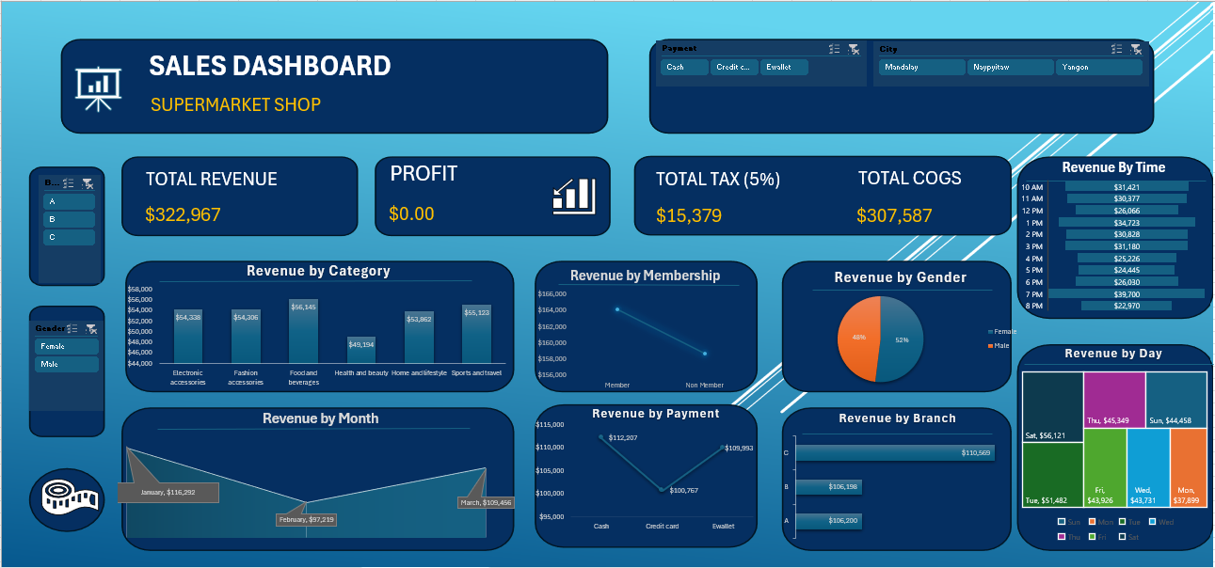

Slide 6
KEY INSIGHTS
Total revenue generated by the supermarket is $322,967
Total profit after the removal of 5% tax and COGS is $0.00
The food and beverages section generated the highest revenue ($56,145).
The highest revenue was generated by branch C ($110,569)
The highest revenue was generated by customers with a membership card ($164,223).
52% of the total sales were generated by females.
The highest sales in the supermarket was at 7pm.
The month at which the supermarket made the most sales was in January ($116,292).
The highest revenue was generated on Saturday ($56,121).
The preferred mode of payment is cash.

Slide 7
RECOMMENDATIONS
Negotiate better terms with suppliers to reduce costs and increase pricing flexibility.
Focus on stocking the highest selling items more prominently.
Improve operational efficiencies to reduce overhead costs, allowing for more competitive pricing.
Highlight the value and benefits of products, not just the price, to justify pricing decisions.
Utilize advanced pricing software that can analyze vast amounts of data and recommend optimal prices.
Implement models that adjust prices based on real-time supply and demand, competitive prices, and inventory levels.
Leverage AI to predict consumer behavior and optimize pricing in real-time.

